Slide 1


NEXT GEN EMPLOYABILITY PROGRAM
CREATING A FUTURE-READY WORKFORCE
Student Name :
Shah Nawaz
Student ID :
STU65e150d7749fa1709265111
Mobile No :
9398874956
Mail ID :
2203a51l87@sru.edu.in
College Name :
SR University,Warangal.

Slide 2
CAPSTONE PROJECT SHOWCASE
Project Title
Health Care Data Driven Decisions
using Power BI (DA)
Abstract | Problem Statement | Project Overview | Proposed Solution | Technology Used | Modelling & Results | Conclusion | Q&A

Slide 3
Abstract
1
Utilization of Power BI for healthcare data analysis.
2
Focus on patient demographics, medical history, and clinical outcomes.
3
Improve decision-making for better patient outcomes.
4
Develop interactive dashboards for data visualization and analysis

Slide 4


Problem Statement
Inefficient analysis of large healthcare datasets.
Lack of agility in traditional analysis methods.
Need for streamlined processes and empowerment of healthcare professionals.
Objective: Extract valuable insights from complex datasets.

Slide 5

Project Overview
Week 1: Importing and Preprocessing
- Import and clean data.
- Prepare data for analysis.
- Ensure data quality.
Week 2: Data Analysis Expression (DAX)
- Learn DAX language.
- Perform calculations and aggregations.
- Implement advanced analysis.
Week 3: Visualization and Dashboard
- Create visualizations.
- Design interactive dashboards.
- Customize for effective insights.
Week 4: Formatting and Testing
- Format dashboards professionally.
- Test for accuracy and functionality.
- Incorporate feedback for improvement.

Slide 6
Proposed Solution
Build interactive dashboards using Power BI.
Incorporate advanced data modeling and machine learning algorithms.
Enable stakeholders to drill down into specific metrics.
Benefit: Informed decision-making and resource optimization.
Utilize Power BI to construct interactive dashboards, offering dynamic data exploration and visualization.
Implement sophisticated data modeling methodologies and integrate machine learning algorithms to uncover complex patterns and trends.
Empower stakeholders with the ability to delve into specific metrics and customize views for their unique needs.
Drive informed decision-making and resource optimization by providing actionable insights derived from comprehensive data analysis.

Slide 7
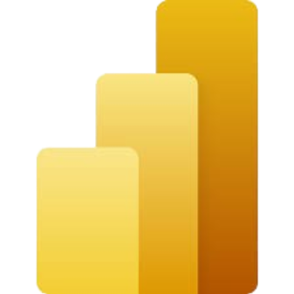

Technology used
Power Bi
Excel Spreadsheet

Slide 8
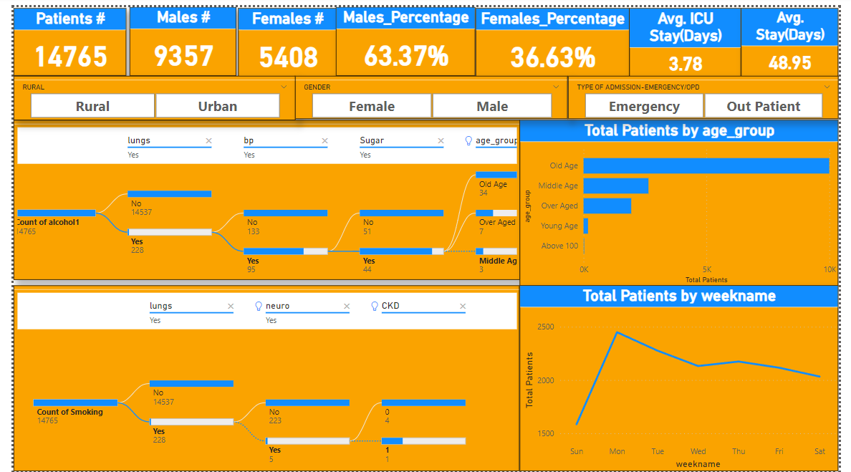
Modelling & Result

Slide 9
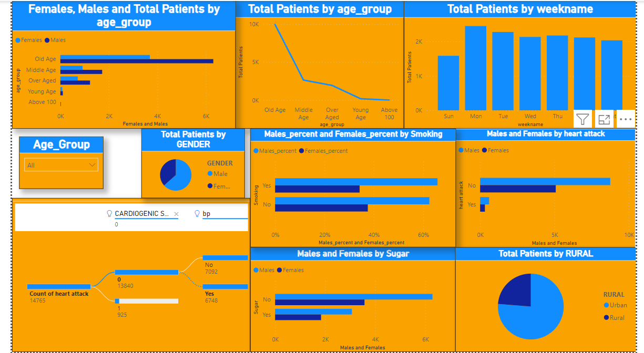
Modelling & Result

Slide 10
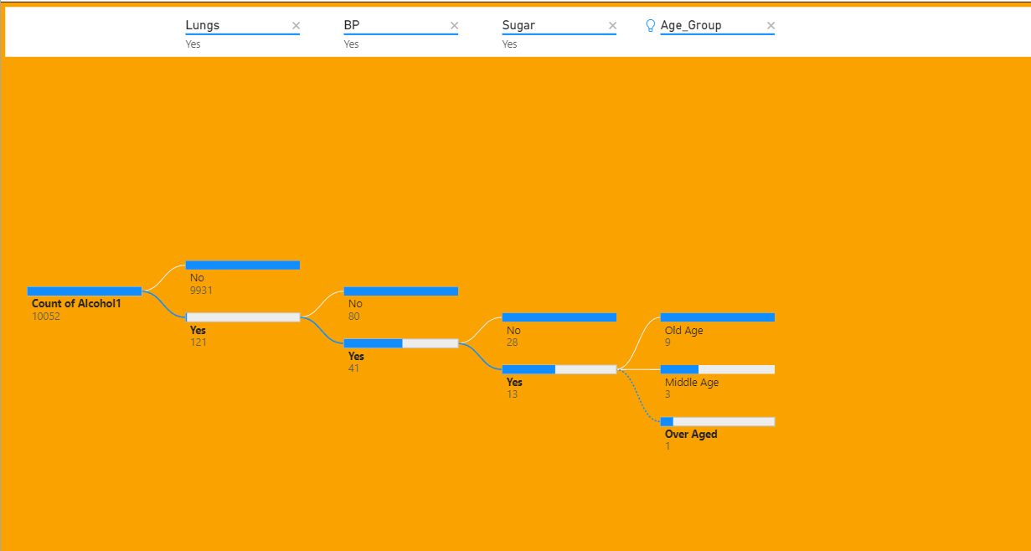
Modelling & Result
The decomposition tree visual provides a detailed breakdown of the count of people who consume alcohol and whether they are affected by diseases related to lungs, blood pressure (BP), and blood sugar, categorized by age group. This allows for an analysis of:
Prevalence of Diseases: How common certain diseases are among alcohol consumers.
Disease Correlation: Possible correlations between alcohol consumption and these health issues.
Age-Related Health Patterns: How age groups differ in terms of health risks associated with alcohol consumption.
This data can be crucial for identifying risk factors and informing healthcare strategies

Slide 11
Modelling & Result
Card Visual

Slide 12
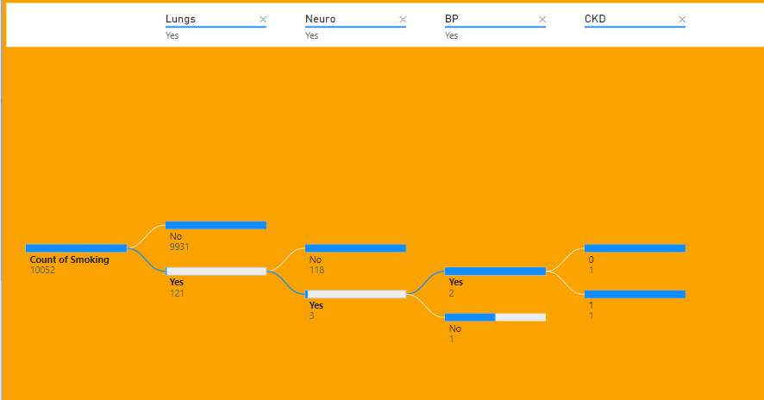
Modelling & Result
The decomposition tree visual provides a detailed breakdown of the count of people who smoking and whether they are affected by diseases related to lungs, blood pressure (BP), and CKD, categorized by age group. This allows for an analysis of:
Prevalence of Diseases: How common certain diseases are among alcohol consumers.
Disease Correlation: Possible correlations between smoking and these health issues.
Age-Related Health Patterns: How age groups differ in terms of health risks associated with smoking.
This data can be crucial for identifying risk factors and informing healthcare strategies

Slide 13
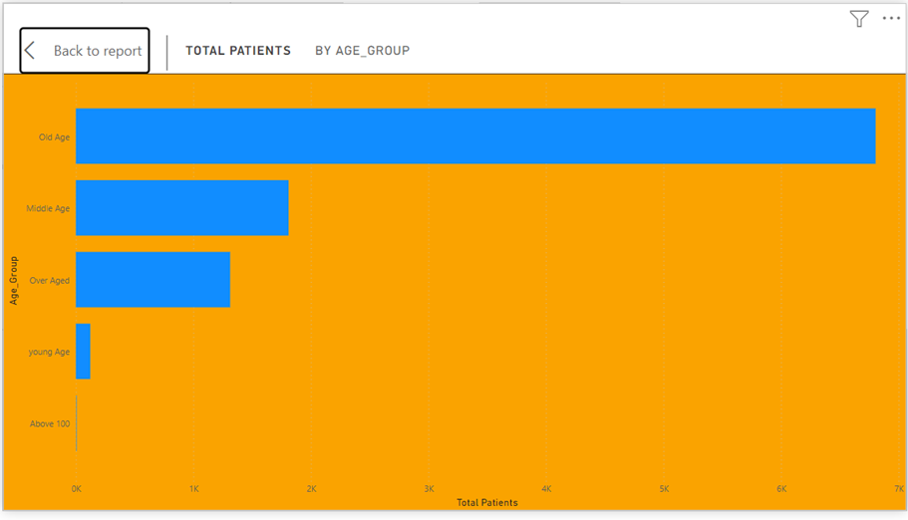
Modelling & Result
The “Total Patients by age distribution” stacked bar chart indicates:
High number of older patients.
Middle-aged and over-aged groups also significant.
Young and very old age groups have fewer patients.
Implications for healthcare resource planning and preventive care.

Slide 14
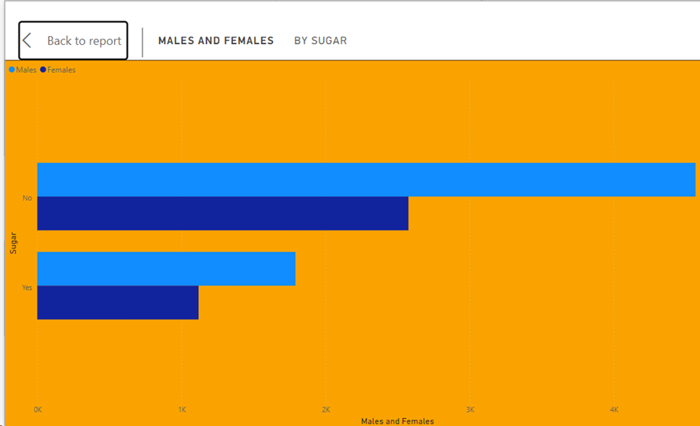
Modelling & Result
The clustered bar chart, if related to
“sugar disease” which is commonly diabetes, could provide insights such as:
Gender Disparity: It may indicate a gender disparity in diabetes prevalence or management.
Healthcare Focus: The data could inform healthcare providers to focus on the gender with a higher rate of diabetes for interventions.
Understanding which gender has a lower rate of diabetes could guide preventive measures and lifestyle modifications.
This analysis can help in addressing diabetes more effectively within the population represented in the chart.

Slide 15
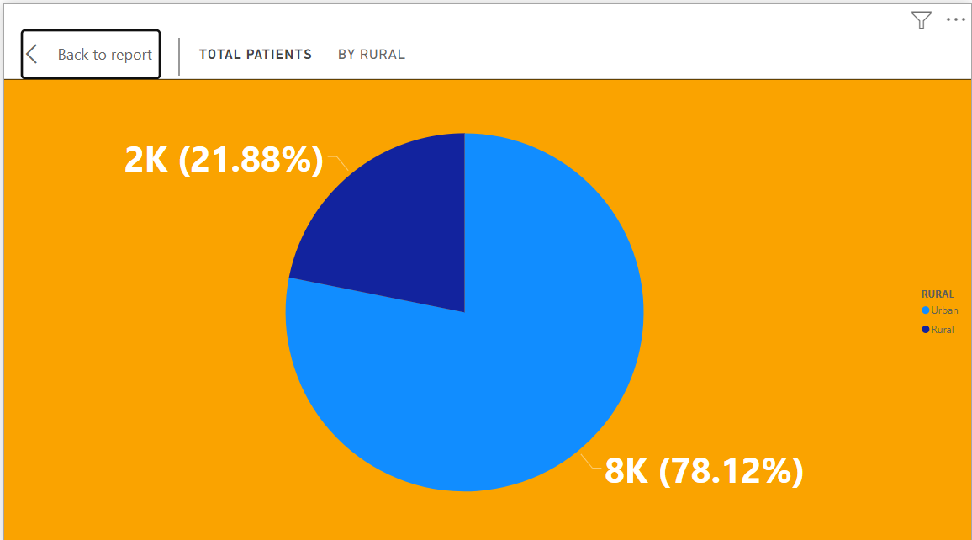
Modelling & Result
The pie chart titled “TOTAL PATIENTS BY RURAL” provides insights into the distribution of patients between rural and urban areas:
Urban Concentration: A significant majority, 78.12% (8K patients), are in urban areas, suggesting a higher population density or better access to healthcare facilities.
Rural Representation: Only 21.88% (2K patients) are in rural areas, which could point to limited healthcare resources or lower population density.
This data is crucial for healthcare planning, indicating a need to improve healthcare accessibility in rural regions.

Slide 16

Conclusion
Using Power BI in healthcare has been a game-changer. It's made complex data easy to understand through visuals like charts and graphs. This helped healthcare workers make smarter decisions, leading to better patient care and smoother operations. With Power BI, we could even predict future trends in healthcare, allowing us to plan ahead and prevent problems before they happen. Plus, it's user-friendly, so everyone on the healthcare team can use it, no matter their technical skills. Overall, Power BI has made healthcare better by giving us the tools to see, understand, and improve how we care for patients.

Slide 17


Notes:
Thank You !!

